Slide 1
UTECH, JA Virtual CAMPUS TOUR
Presenters: Tariq burch & Abigail Nembhard

Slide 2
Scenario
You have been asked as a part of a Design team to develop a UTech, Jamaica Virtual Campus Tool as a programmable interface design using principles within usability engineering to support its Human Computer Interface design i.e. from mapping the system requirement , designing the usable system interfaces , and end user acceptance testing.
The team needs to operate as an Agile Development team from the start of the project to produce the most appropriate design case given the problem domain and context.
The motivation of this project is driven by the fact that UTECH,Ja is seeking to improve its customer experience by inviting prospective students as well returning students to benefit from an understanding of what is happening in and around the campus as well as to engage in the student teaching and learning experiences of the campus as well as the social experiences around the campus.
Based on the scenario above, we carried out a questionnaire to get the opinions of students about virtual campus tour tool.

Slide 3
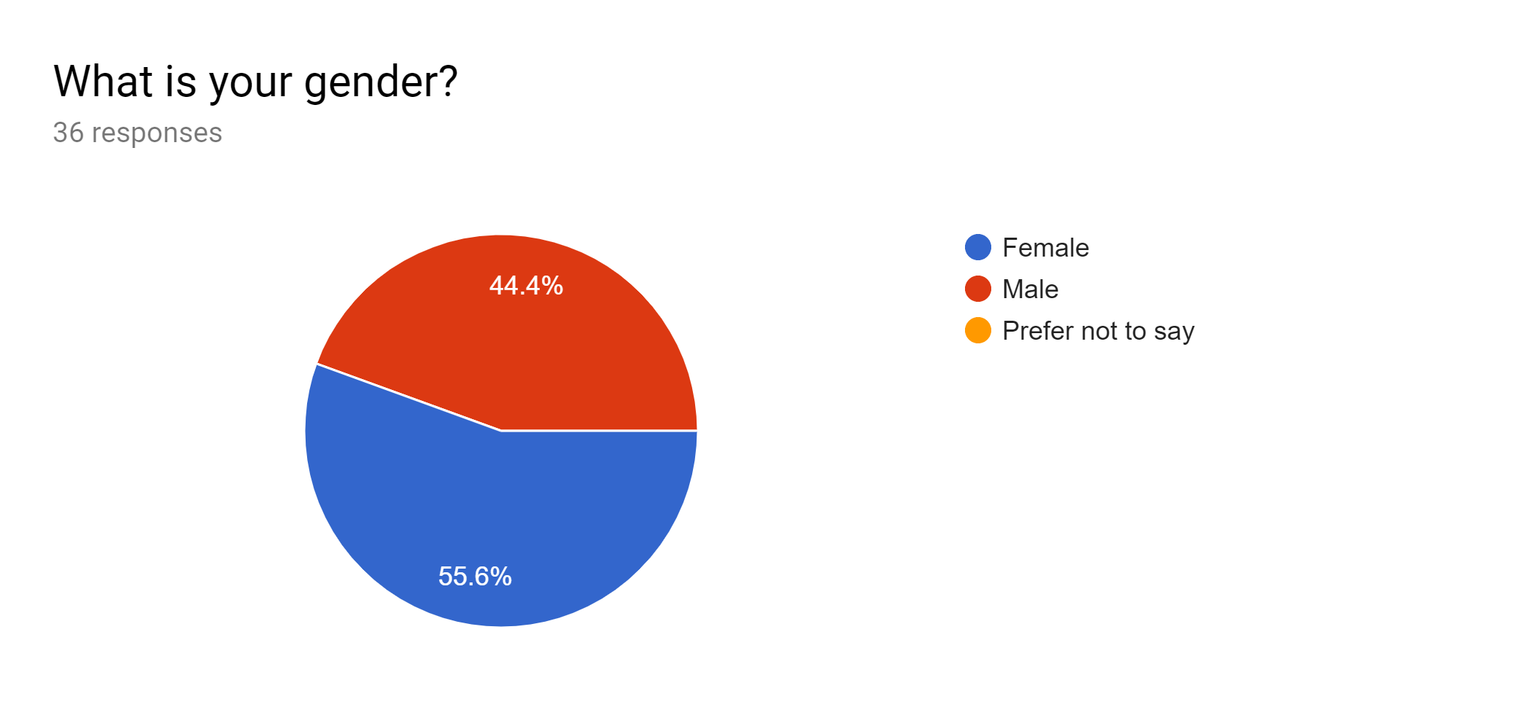
Question 1

Slide 4
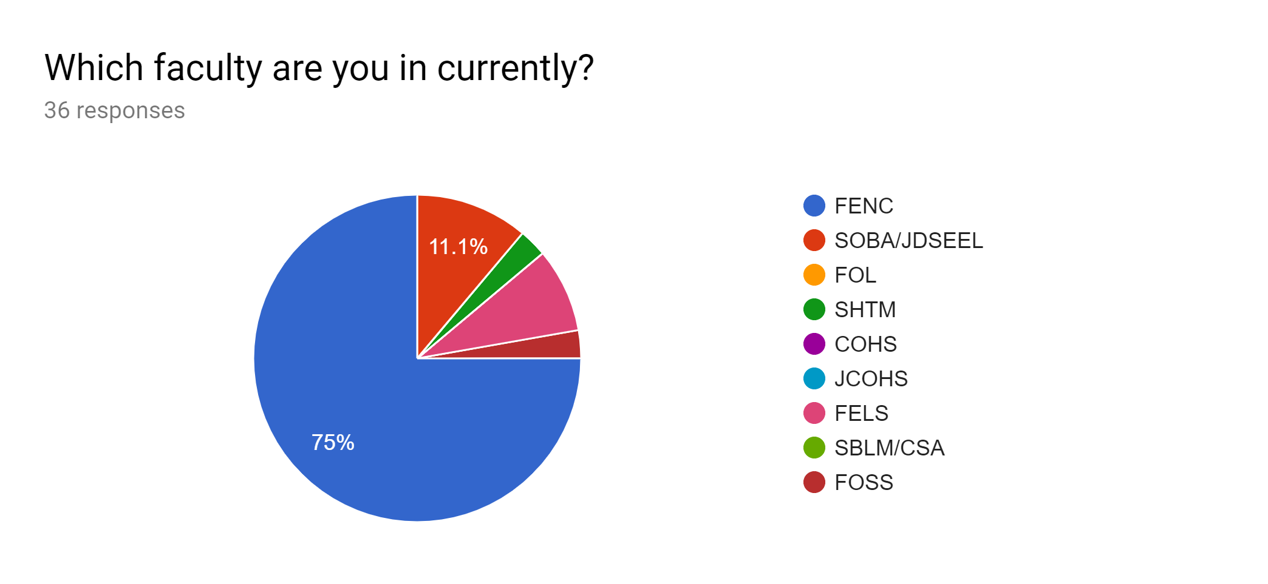
Question 2

Slide 5
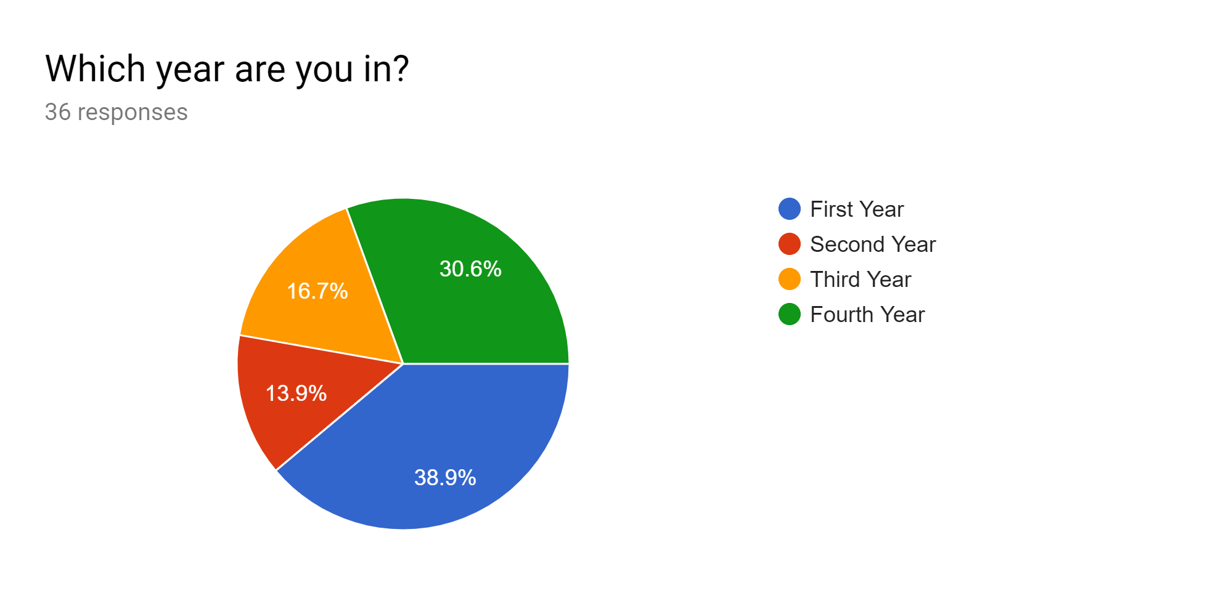
Question 3

Slide 6
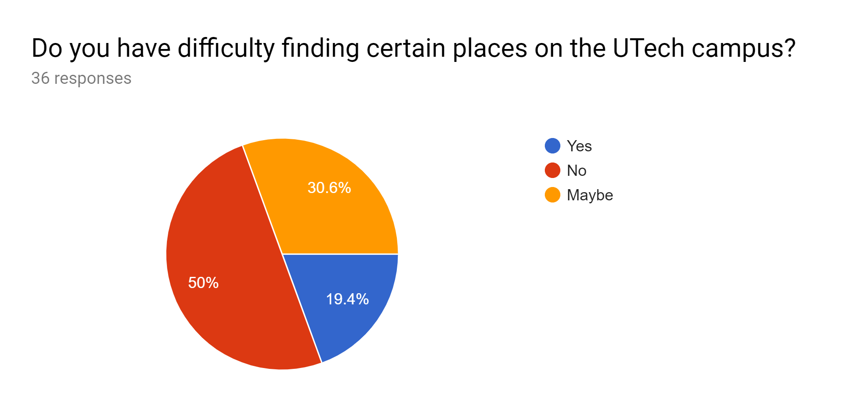
Question 4

Slide 7
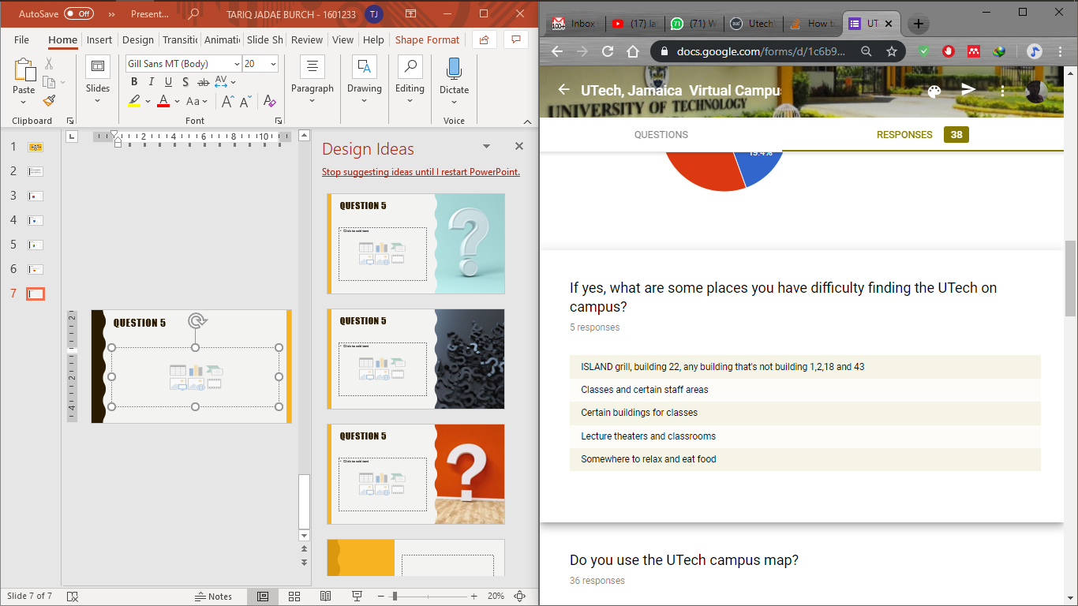
Question 5

Slide 8
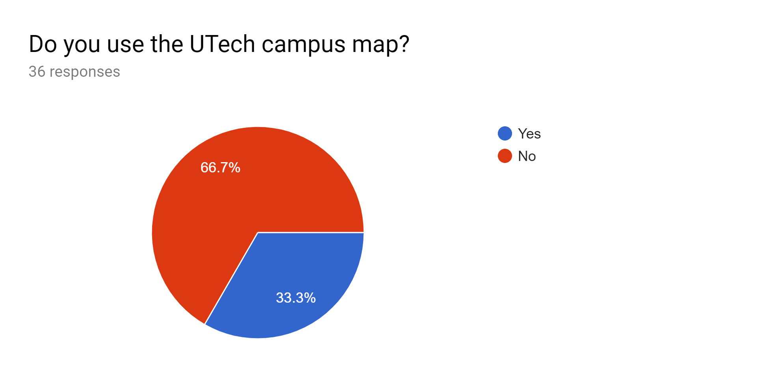
Question 6

Slide 9
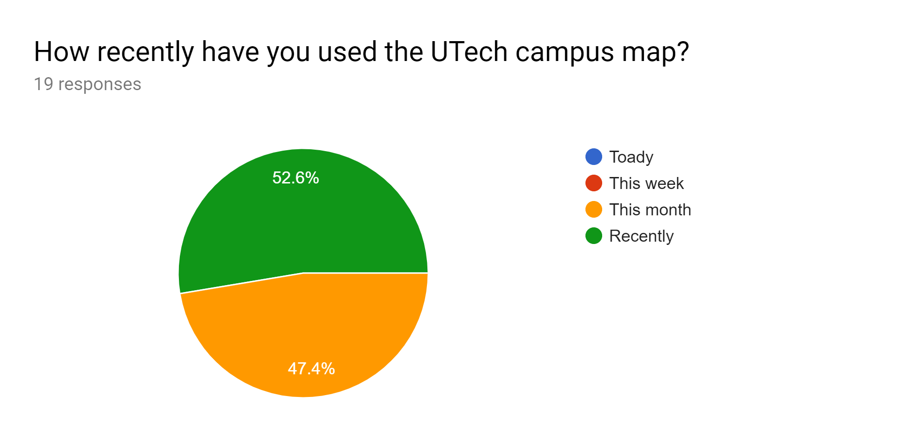
Question 7

Slide 10
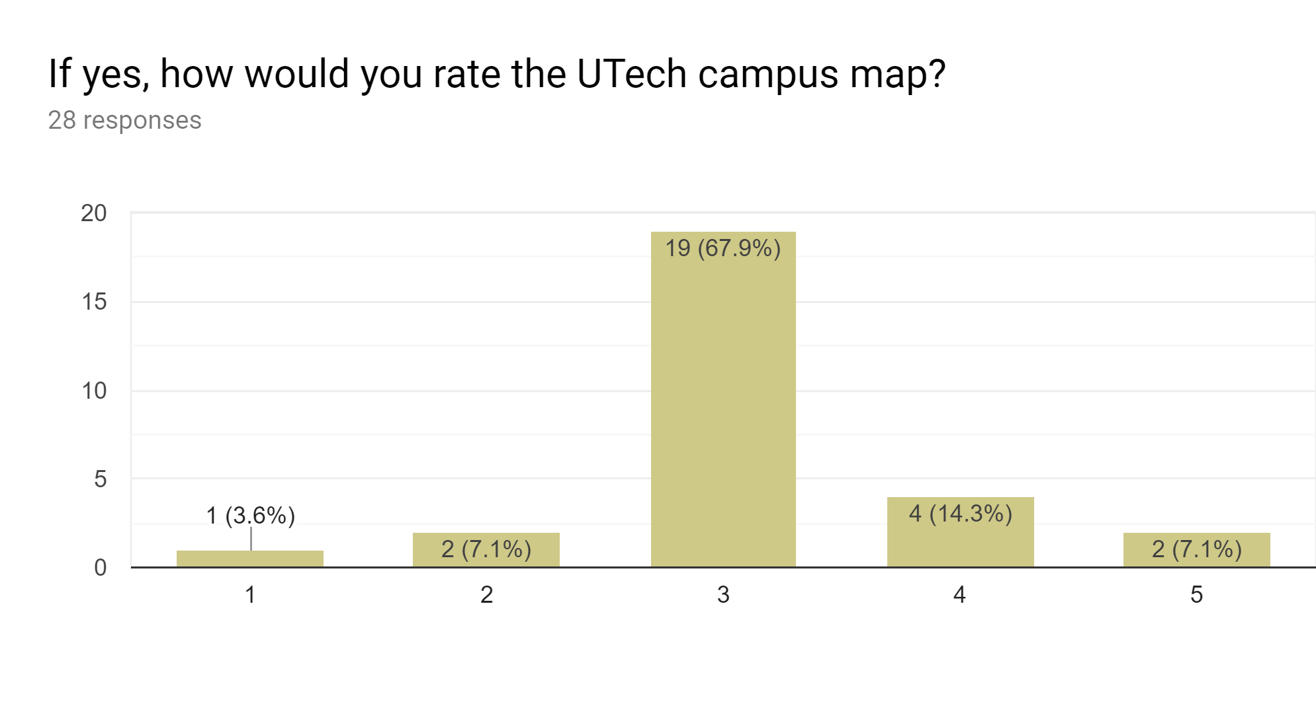
question8

Slide 11
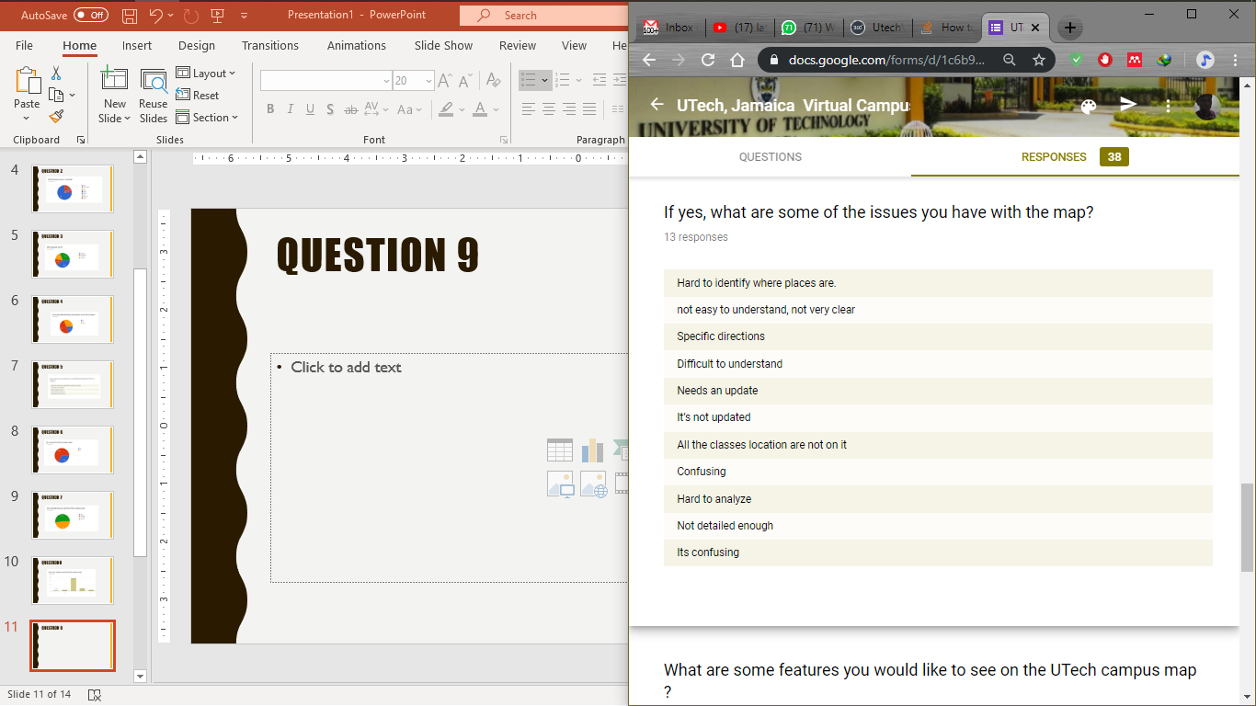
Question 9

Slide 12
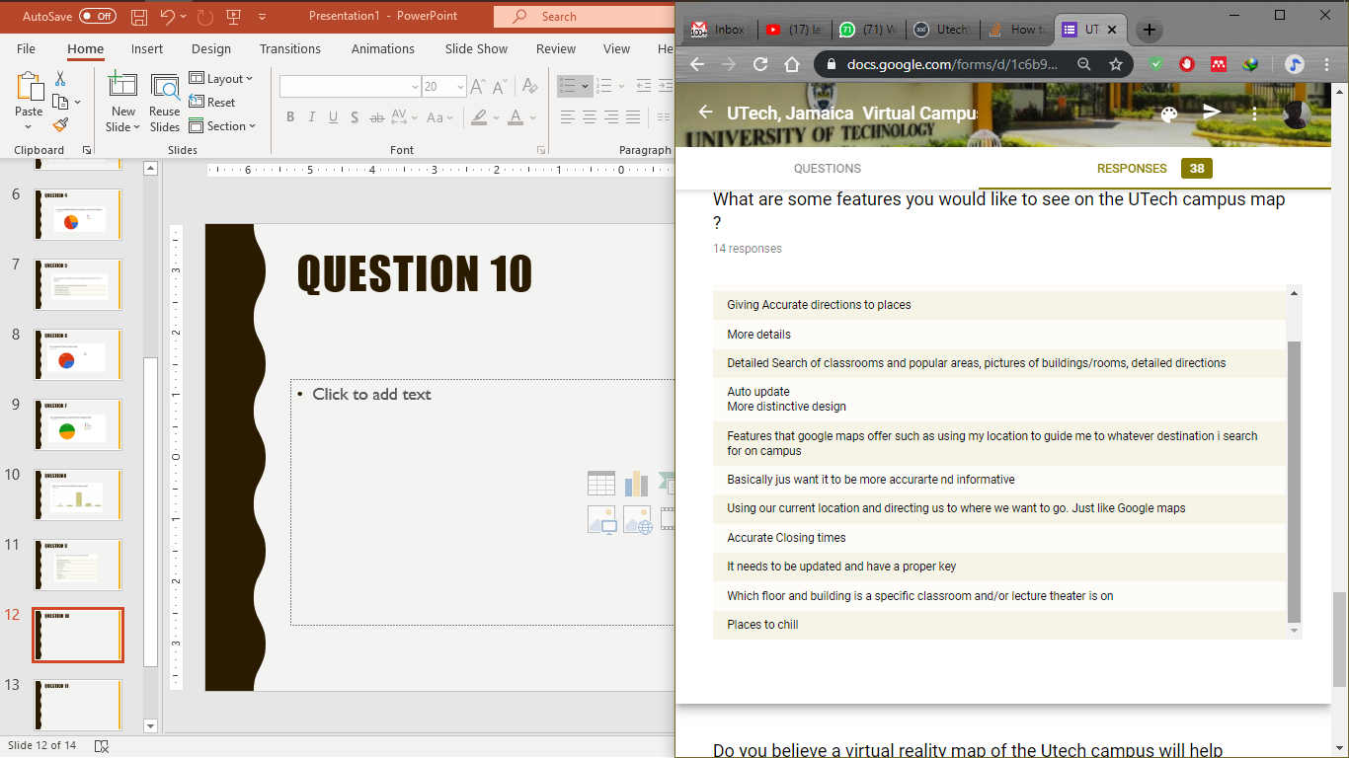
Question 10

Slide 13
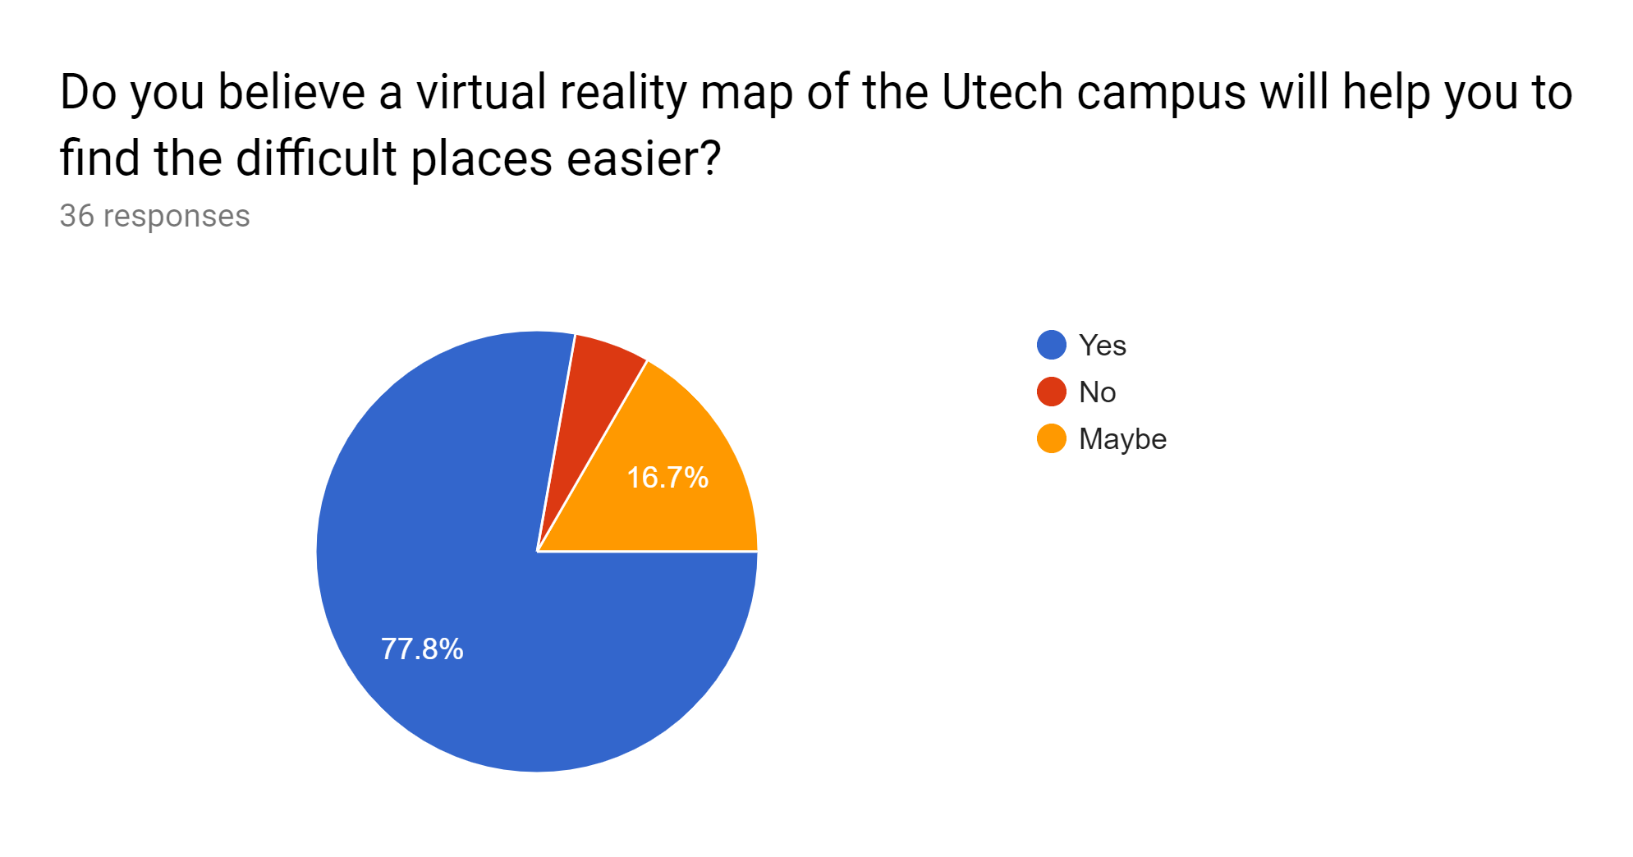
Question 11

Slide 14
Discussion
Based on the survey carried out, most of our respondents were from the Faculty of Engineering and Computing (75% of respondents) who span over the various year groups equally, so we got a fair idea of students view. The survey showed that 50% of the respondents had difficulty finding certain places on the campus(Building 22, Food places, certain classrooms and chill places). It also showed that 66.7% of the respondents don’t use the campus map at all so we can safely say that most students aren’t aware of the map because no one used the map either today of this week. Those who used the map find it confusing , outdated, not detailed etc. Respondents have asked for a more detailed and interactive system to catch the eye of the students.

Slide 15
MAKEVT.com
We chosen makevt.com because its a cloud service, so you don’t need to keep files on your computer. You also don’t need to install anything. Makevt allows you to use a transition scheme for a virtual tour: a graphic scheme of panoramas used in the virtual tour and transitions between them. Apply a layout algorithm and modify the graph by hand. This means that you don’t need to keep the transitions in your mind anymore.

